Slide 1
Car Accident Severity
By
Prasanthi Putta

Slide 2
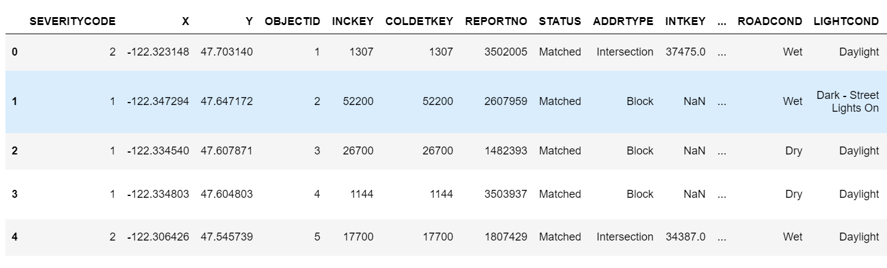
Data Set
Contains totally 37 attributes and 194673 instances

Slide 3

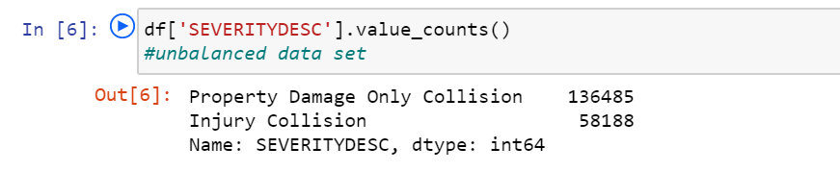
Data Set (cont..)
Data Set Size:
Data Set Type = Unbalanced labeled data set

Slide 4
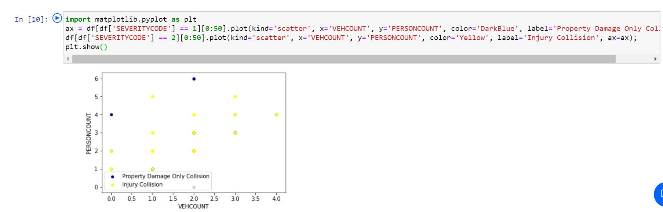
Data Visualization
Understanding the data attributes by Plotting scatter plot to find the relation between attributes with accident severity

Slide 5
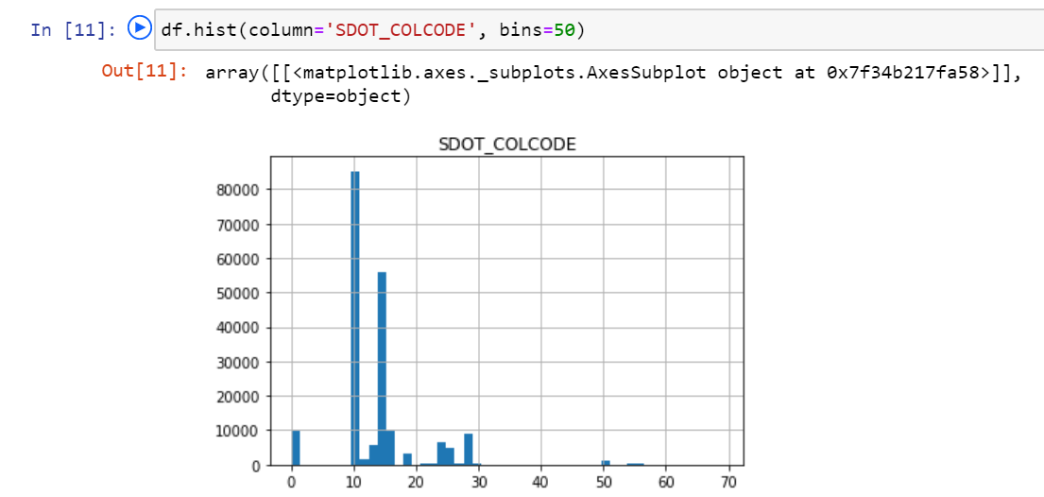
Data Visualization (cont..)
Plotting histogram for collision description and found “MOTOR VEHICLE STRUCK MOTOR VEHICLE, REAR END” causes more accidents.

Slide 6
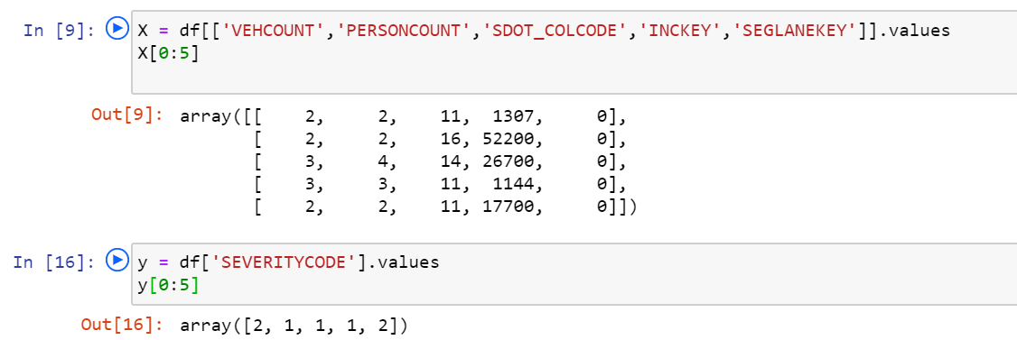
Model Selection
K-nearest neighbors algorithm
Feature Attributes and Target Variable:
SEVERITYCODE | SEVERITYDESC
1 | Property Damage Only Collision
2 | Injury Collision

Slide 7
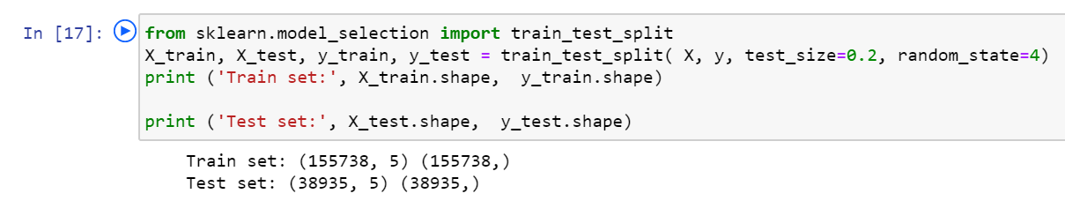
Splitting Data Set for training and testing
Training Set: 80%
Testing Set: 20%

Slide 8
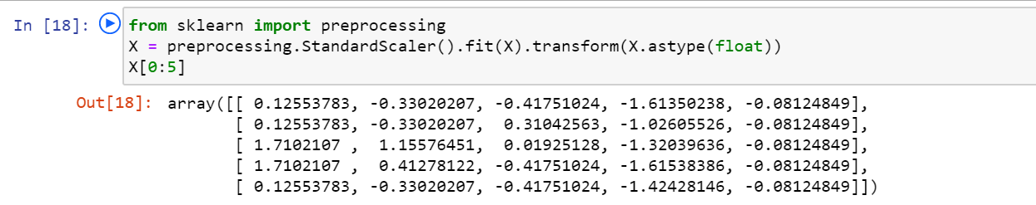
Building the model
Building the model using preprocessing module from scikit learn

Slide 9
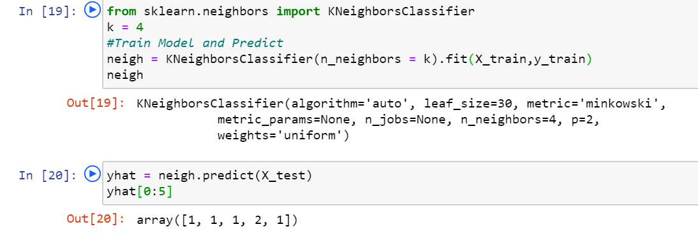
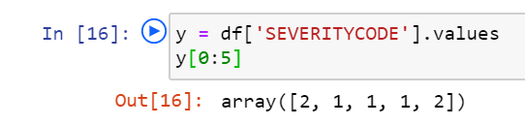
Building the model:
Initially K set to 4:
After building the model with k=4, only two accidents are predicted correctly for 5 instances

Slide 10
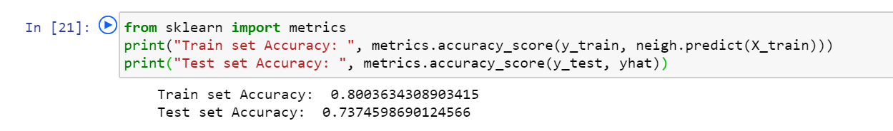
Model Evaluation
Accuracy = 74%

Slide 11
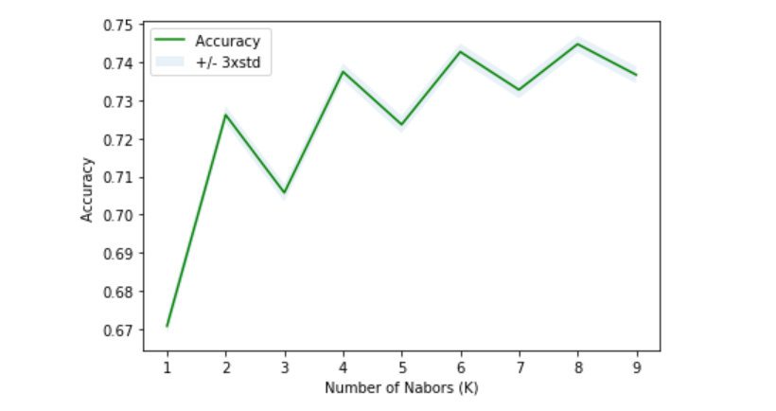
Model Evaluation
Best Accuracy: 75% when k=8

Slide 12
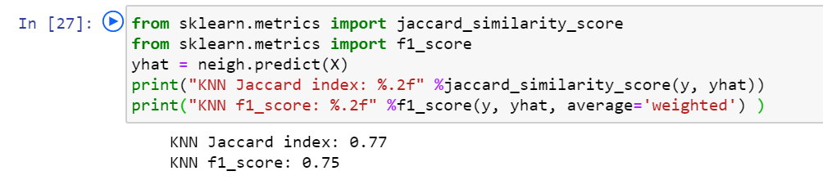
Model Evaluation
Using Jaccard Index and F1_Score

Slide 13
Conclusion
We got approximately 75% accuracy for the car accident severity data set with 194673 instances using k-nearest neighbors algorithm.

Slide 14
Thank You

